Slide 1


Lecture #0
CSE332
INDUSTRY ETHICS AND LEGAL ISSUES
Notes:
To view this presentation, first, turn up your volume and second, launch the self-running slide show.

Slide 2
Course Overview
CSE510, Lovely Professional University, Phagwara
L T P : Credits:2
Text Book:
1. ETHICS IN INFORMATION TECHNOLOGY by GEORGE W REYNOLDS, CENGAGE LEARNING
Reference books:
“INTELLECTUAL PROPERTY RIGHTS-LAW AND PRACTICE” by ICSI House, 22, Institutional Area, Lodi Road, New Delhi 110 003
2 | 0 | 0

Slide 3
Marks Breakup:
* 2 Best CA out of 3 CA (Class test, MCQ).
CA1 (Class Test) will be held on 5th Week
CA2 (Class Test) Will be held on 9th Week
CA3 (Class Test) Will be held on 12th Week
Activity | Marks
Attendance | 5
Continuous Assessment (CA)* | 25
Mid-Term Examination (MTE) | 20
End-Term Examination (ETE) | 50
Total | 100
CSE332, Lovely Professional University

Slide 4

What is an Industry ethics and legal issues

Slide 5
What is an Industry?
Any type of Economic Activity producing products or
Services.
It is part of a chain –from raw materials to finished product, finished product to service sector, and service sector to research and development.
Eg:-Google Assistant(product) launched by Google

Slide 6
ETHICS
Again

Slide 7
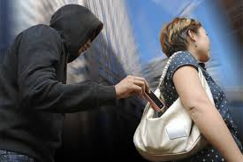
ETHIC! a big question mark

Slide 8

SECOND SITUATION

Slide 9
Ethics
Computer ethics is a system of moral standards or values used as a guideline for computer users.
Eg:- Google has released what is effectively a rulebook for how the company will apply AI technology
The seven principles include making sure that AI is applied to applications that are socially beneficial, safe and won't create unfair bias.

Slide 10
Legal Issues
A legal issue can be any question of law that arises from a particular set of facts.
To prevent the misuse of computers.
Eg:- Copying and Legal Issues
make sure your research and development teams thoroughly research the patents and copyrights of your current product, to avoid a messy legal battle should you step on a competitor's toes.

Slide 11
Learning Outcomes
By the end of this course students will be able to:
To understand ethical environment of work.
Understand about the latest trends and current issues in information technology.
Describe the various types of funding and schemes for start up business in IT sector.
Comply with various cyber laws and related semantics for deploying security mechanisms in IT industry.
Understand various types of legal, ethical and professional issues in Information Security.
Understand the concept of intellectual properties.

Slide 12
Learning Outcomes
Reflectively judge the morality of behaviours involving the use of computers
Defend or attack a wide range of moral and/or legal standpoints involving the use of computers.
Recognize and act upon legal issues and constraints in computing

Slide 13









6
UNITS
Notes:
Along the way we’ve discovered…

Slide 14
UNIT 1
Ethics
What is an ethical work environment,
Ethical behavior of IT professional.
Common ethical issues for IT users

Slide 15
UNIT 2
Companies
What are the companies act
What is NASSCOM,
What is STPI
And Recent technology advancement,
Notes:
NASSCOM, a not-for-profit industry association, is the apex body for the 154 billion dollar Indian IT BPM industry.
Software Technology Parks of India is a society established in 1991 by the Indian Ministry of electronics and Information Technology with the objective of encouraging, promoting and boosting the export of software from India

Slide 16
UNIT 3
Government Funding and schemes for Startup
What are Startups.
Benefit of startups.

Slide 17
UNIT 4
Startup in IT
Idea
Planning
General company Description,
Marketing plan,
Operational plan, Management
And the most important…………...

Slide 18


Slide 19
UNIT 5
Legal, Ethical and Professional issues in Information Security:
What is Cyber Crime?
Cyber law of India
Need for cyber law in India

Slide 20
UNIT 6
What is Intellectual Properties ?
What is the need?
How we can do it

Slide 21

Intellectual Properties

Slide 22
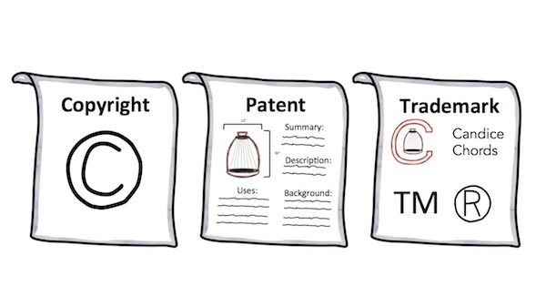
Types of IP

Slide 23
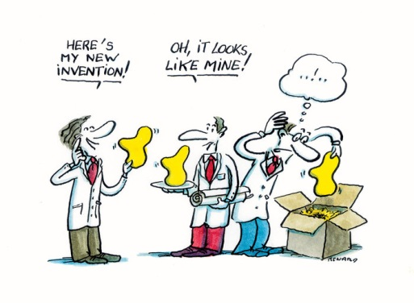
NEED

Slide 24

Any practical example

Slide 25


How we can?
For this question you need to listen

Slide 26

CSE510, Lovely Professional University, Phagwara
Thank You !!!

Slide 27
CSE510, Lovely Professional University, Phagwara
Next Class:
Ethics
ETHICS IN THE BUSINESS WORLD
What is an ethical work environment

